Slide 1
Unit 14 Transformer
Part A: Coupling Coefficient and Mutual Inductance

Slide 2
What will you learn?
Understand the concepts of coupling coefficient.
Understand the relationship between mutual inductance and transformer output voltage.
Know the factors affecting mutual inductance.

Slide 3
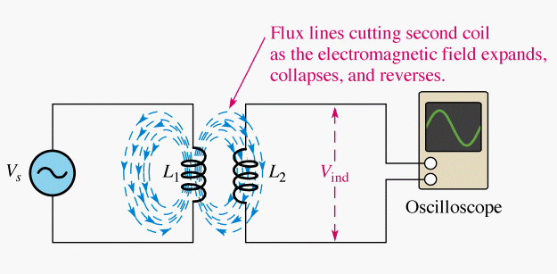
Coefficient of Coupling
A transformer has 2 coils: primary coil and secondary coil.
An alternating current flows in the primary coil.
A constantly changing magnetic field is generated around the primary coil.
The changing magnetic flux lines cut through the secondary coil.
An AC voltage is induced across the secondary coil because of electromagnetic induction.
The 2 coils are magnetically coupled but electrically isolated as there is no electrical connection between them, only a magnetic link.

Slide 4
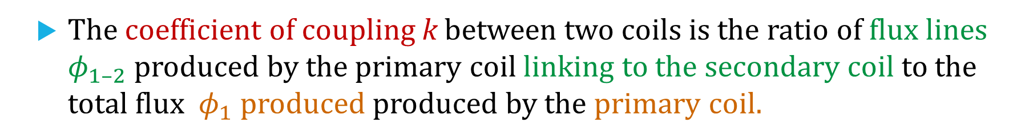
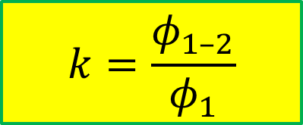
Coefficient of Coupling
The coefficient of coupling k between two coils is the ratio of flux lines $φ_{1–2}$ produced by the primary coil linking to the secondary coil to the total flux $φ_{1}$ produced produced by the primary coil.
$$k=\frac{φ_{1–2}}{φ_{1}}$$
E.g. if total flux produced is 100 mWb & 60 mWb of this link to the secondary coil, then k = 0.6 .

Slide 5
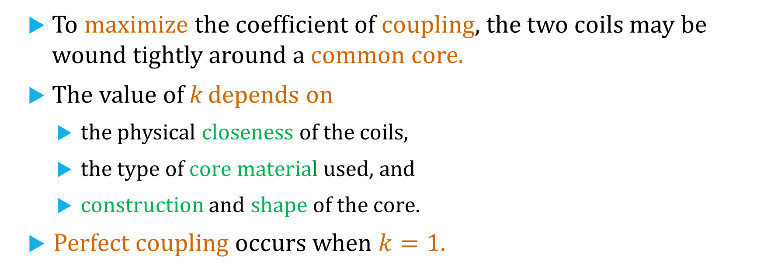
Coefficient of Coupling
To maximize the coefficient of coupling, the two coils may be wound tightly around a common core.
The value of k depends on
the physical closeness of the coils,
the type of core material used, and
construction and shape of the core.
Perfect coupling occurs when $k=1$.

Slide 6
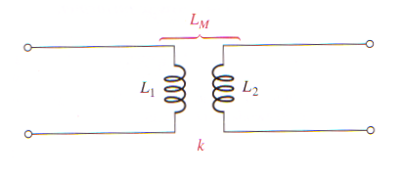



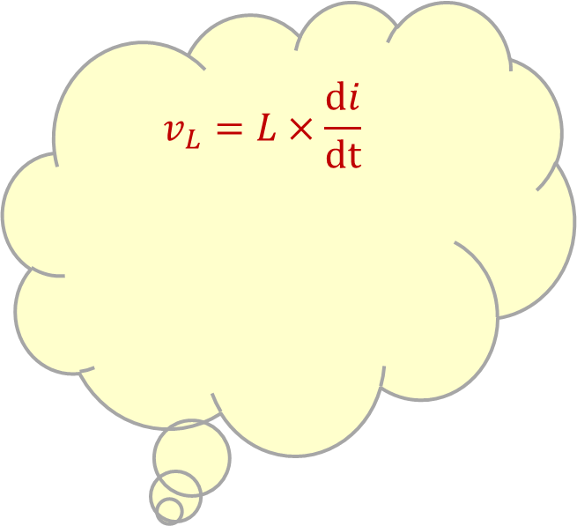

Mutual Inductance
The amount of voltage induced in the secondary coil depends on the mutual inductance L_{M} present between the two coils.
L_{M} in turn depends on the self inductance of each coil (L₁ and L₂) and the coefficient of coupling k between them.
$$v_{L}=L×\frac{di}{dt}$$
$$L_{M}=k\sqrt{L_{1}L_{2}}$$
$$v_{ind}=L_{M} \frac{di}{dt}$$
+
$$v_{L}$$
–
$$i_{L}$$
self-inductance of a coil, L

Slide 7

Example
The primary coil of a transformer produces a total magnetic flux of 50 μWb. If 20 μWb is linked to the secondary coil, what is the coefficient of coupling, k?
Solution
$$k=\frac{φ_{1–2}}{φ_{1}}=\frac{20 μWb}{50 μWb}=0.4$$

Slide 8
Example
Two coils wound on a single core have a coefficient of coupling of 0.3 . The inductances of the primary coil and secondary coil are 10 μH and 15 μH respectively. Find the mutual inductance of the two coils L_{M}?
Solution
$$L_{M}=k\sqrt{L_{1}L_{2}}=0.3\sqrt{10 μH×15 μH}=0.67 μH$$

Slide 9

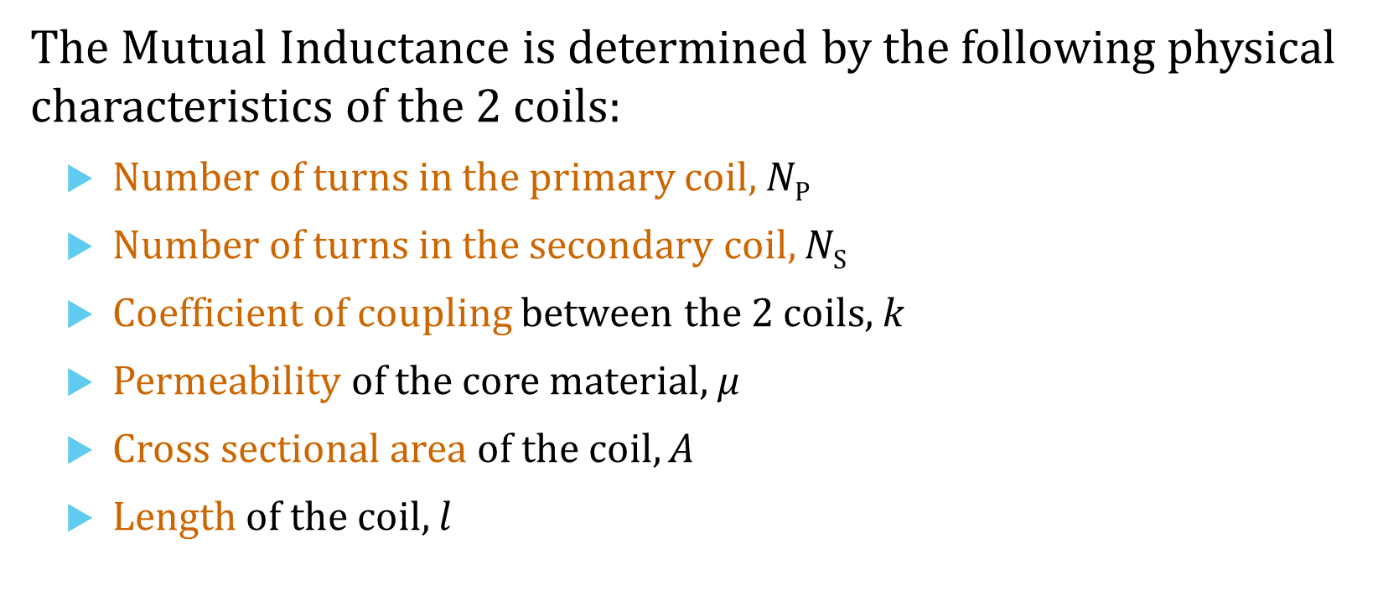
Factors Affecting Mutual Inductance
The Mutual Inductance is determined by the following physical characteristics of the 2 coils:
Number of turns in the primary coil, N_{P}
Number of turns in the secondary coil, N_{S}
Coefficient of coupling between the 2 coils, k
Permeability of the core material, μ
Cross sectional area of the coil, A
Length of the coil, $l$
$$L_{M}=\frac{kN_{P}N_{S}μA}{l}$$

Slide 10

Induced Secondary Voltage
The amount of voltage induced in the secondary coil due to the mutual inductance L_{M} between the two coils is given by
$$v_{ind}=L_{M} \frac{di}{dt}$$
$where \frac{di}{dt} is the rate of change of the primary current$.

Slide 11
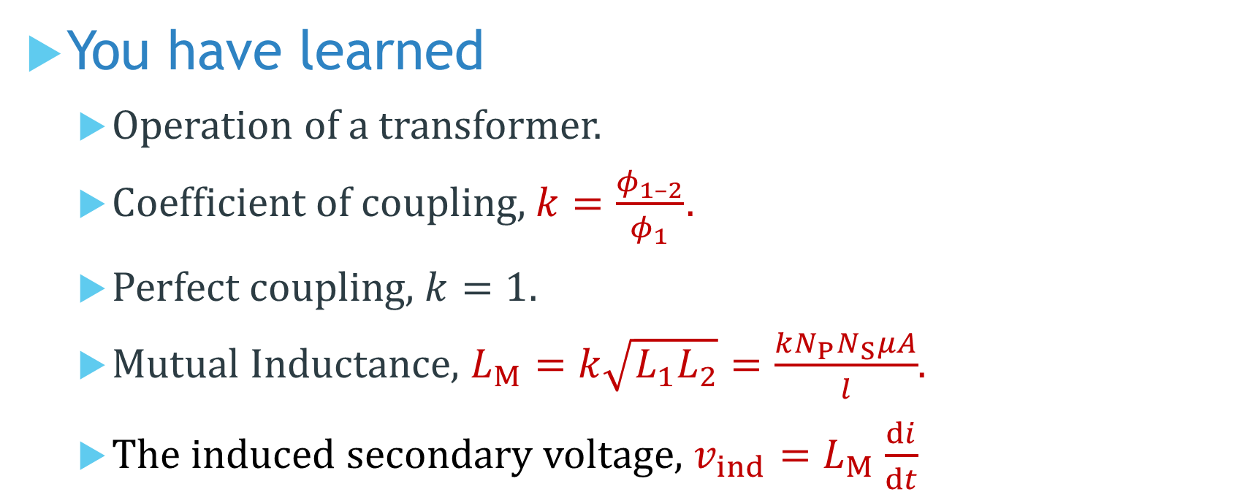
You have learned
Operation of a transformer.
Coefficient of coupling, $k=\frac{φ_{1–2}}{φ_{1}}$ .
Perfect coupling, $k=1.$
Mutual Inductance, $L_{M}=k\sqrt{L_{1}L_{2}}=\frac{kN_{P}N_{S}μA}{l}$.
The induced secondary voltage, $v_{ind}=L_{M} \frac{di}{dt}$

Slide 12
Coming Up Next
Transformer Structure and Turns Ratio

